Slide 1


Day: 17 Explaining the Rule-Based Method
Day: 18 Configuring the Rule-Based Method
Configure Matrix Sales and Cost Eliminations
Describe the Consolidation of Investment Concepts
Update Ownership Data
Consolidation, Ownership Data- Group Shares
Configure Purchase Method Investment Eliminations
Configure Purchase Method Capital Eliminations

Slide 2

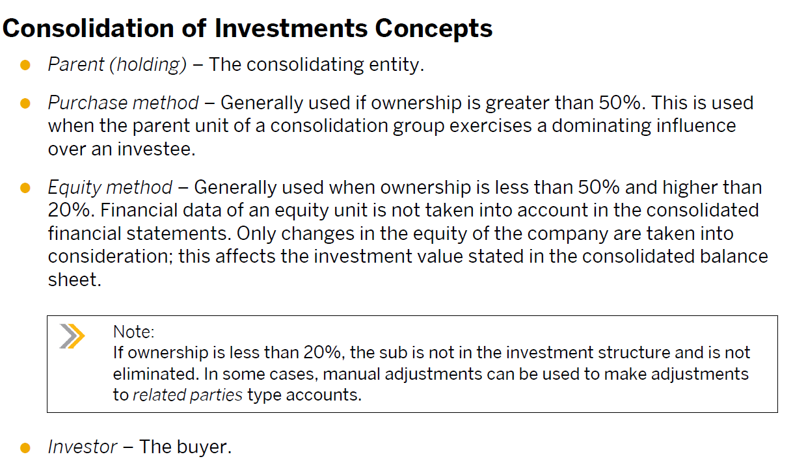
Consolidation Of Investments

Slide 3
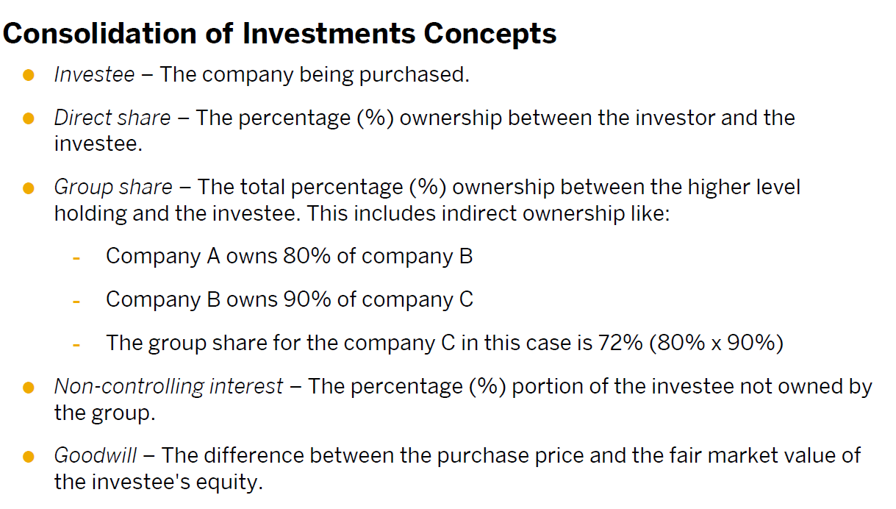

Slide 4
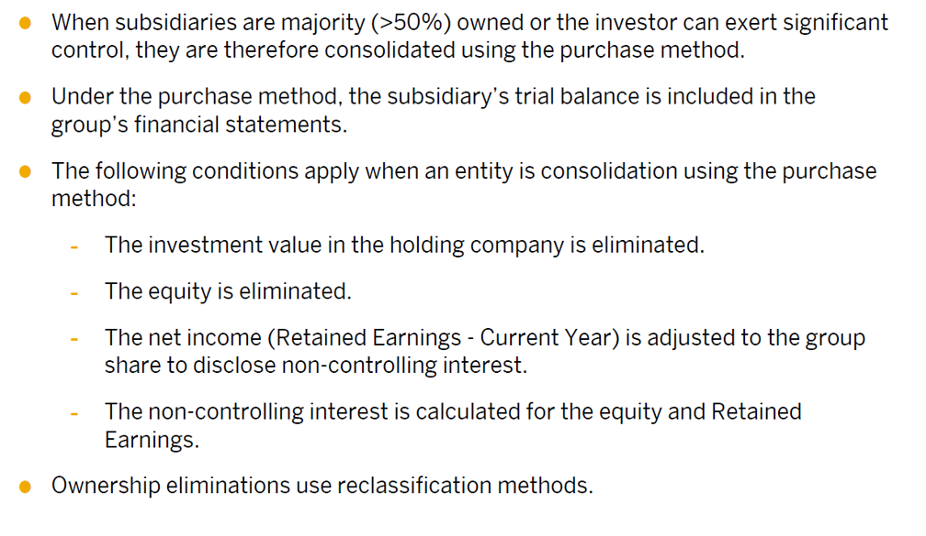
Purchase Method Investment Elimination

Slide 5
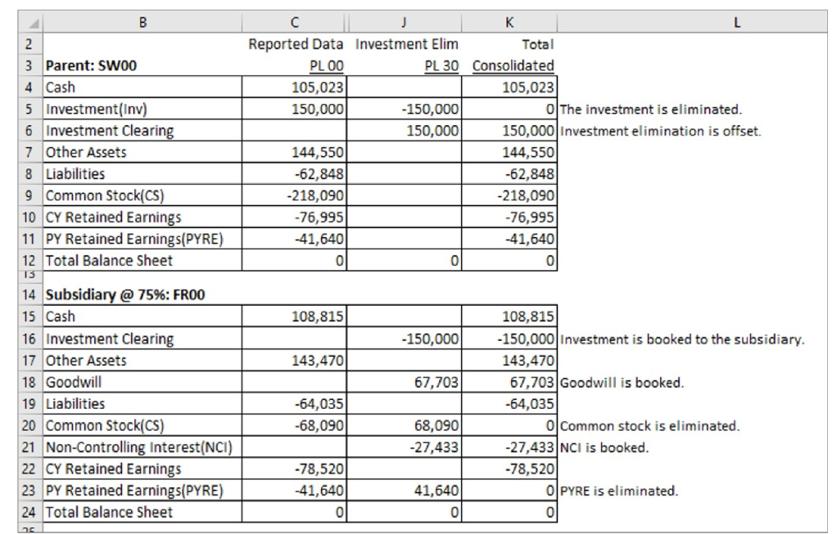

Slide 6
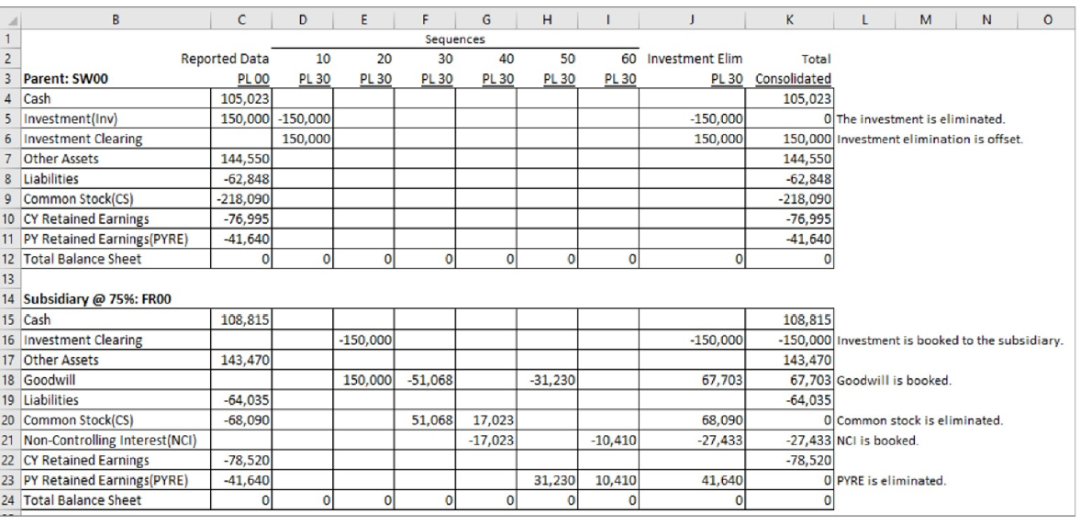

Slide 7
Rule Based Approach
Initial Consolidation
Subsequent Consolidation
Change in Share
Change in Capital
Total Divestiture

Slide 8
Activity Based Consolidation
Initial Consolidation
Subsequent Consolidation
Step Acquisition
Change in Capital
Change in Share
Partial and Total Transfers
Partial Divesture
Total Divesture
Horizontal and Vertical merge

